Slide 1
Data Warehouse and OLAP
Why data warehouse
What’s data warehouse
What’s multi-dimensional data model
What’s difference between OLAP and OLTP

Slide 2
Operational data VS DSS
Operational data and decision support data serve different purposes.
Most operational data are stored in a highly normalized relational database.
Operational data storage is optimized to support transactions that represent daily operations.
For example, each time an item is sold, it must be accounted for, Customer data, inventory data, and so on, are in a frequent update mode.
To provide effective update performance, operational systems store data in many tables, each with a minimum number of fields.

Slide 3
Decision Support Data
From the data analyst’s point of view, decision support data differ from operational data in three main areas:
time span, granularity, and dimensionality.
Time span
Operational data cover a short time frame. In contrast, decision support data tend to cover a longer time frame.
Managers are seldom interested in a specific sales invoice to customer X; rather, they tend to focus on sales generated during the last month, the last year, or the last five years.

Slide 4
Relational Database Theory
Relational database modeling process – normalization, relations or tables are progressively decomposed into smaller relations to a point where all attributes in a relation are very tightly coupled with the primary key of the relation.
  First normal form: data items are atomic,
  Second normal form: attributes fully depend on primary key,
  Third normal form: all non-key attributes are completely independent of each other.
CSE601

Slide 5
Granularity(level of aggregation)
Decision support data must be presented at different levels of aggregation, from highly summarized to near-atomic.
For example, if managers must analyze sales by region, they must be able to access data showing the sales by region, by city within the region, by store within the city within the region, and so on.
In that case, summarized data to compare the regions is required, and also data in a structure that enables a manager to drill down, or decompose, the data into more atomic components (that is, finer-grained data at lower levels of aggregation).
In contrast, when you roll up the data, you are aggregating the data to a higher level.

Slide 6
Dimensionality:
Operational data focus on representing individual transactions rather than on the effects of the transactions over time.
In contrast, data analysts tend to include many data dimensions and are interested in how the data relate over those dimensions.
For example, an analyst might want to know how product X fared relative to product Z during the past six months by region, state, city, store, and customer.
In that case, both place and time are part of the picture.

Slide 7
From the designer’s point of view, the differences between operational and decision support data are as follows:
Time: Operational data represent transactions as they happen in real time. Decision support data are a snapshot of the operational data at a given point in time. Therefore, decision support data are historic, representing a time slice of the operational data.
Type and volume of transaction: Operational and decision support data are different in terms of transaction type and transaction volume. Whereas operational data are characterized by update transactions, decision support data are mainly characterized by query (read-only) transactions.
Decision support data also require periodic updates to load new data that are summarized from the operational data.
Finally, the concurrent transaction volume in operational data tends to be very high when compared with the low-to-medium levels found in decision support data.

Slide 8
Operational data are commonly stored in many tables, and the stored data represent the information about a given transaction only.
Decision support data are generally stored in a few tables that store data derived from the operational data.
The decision support data do not include the details of each operational transaction.
Instead, decision support data represent transaction summaries; therefore, the decision support database stores data that are integrated, aggregated, and summarized for decision support purposes.
The degree to which decision support data are summarized is very high when contrasted with operational data. Therefore, you will see a great deal of derived data in decision support databases.
For example, rather than storing all 10,000 sales transactions for a given store on a given day, the decision support database might simply store the total number of units sold and the total sales dollars generated during that day. Decision support data might be collected to monitor such aggregates as total sales for each store or for each product. The purpose of the summaries is simple: they are to be used to establish and evaluate sales trends, product sales comparisons, and so on, that serve decision needs.
CSE601

Slide 9
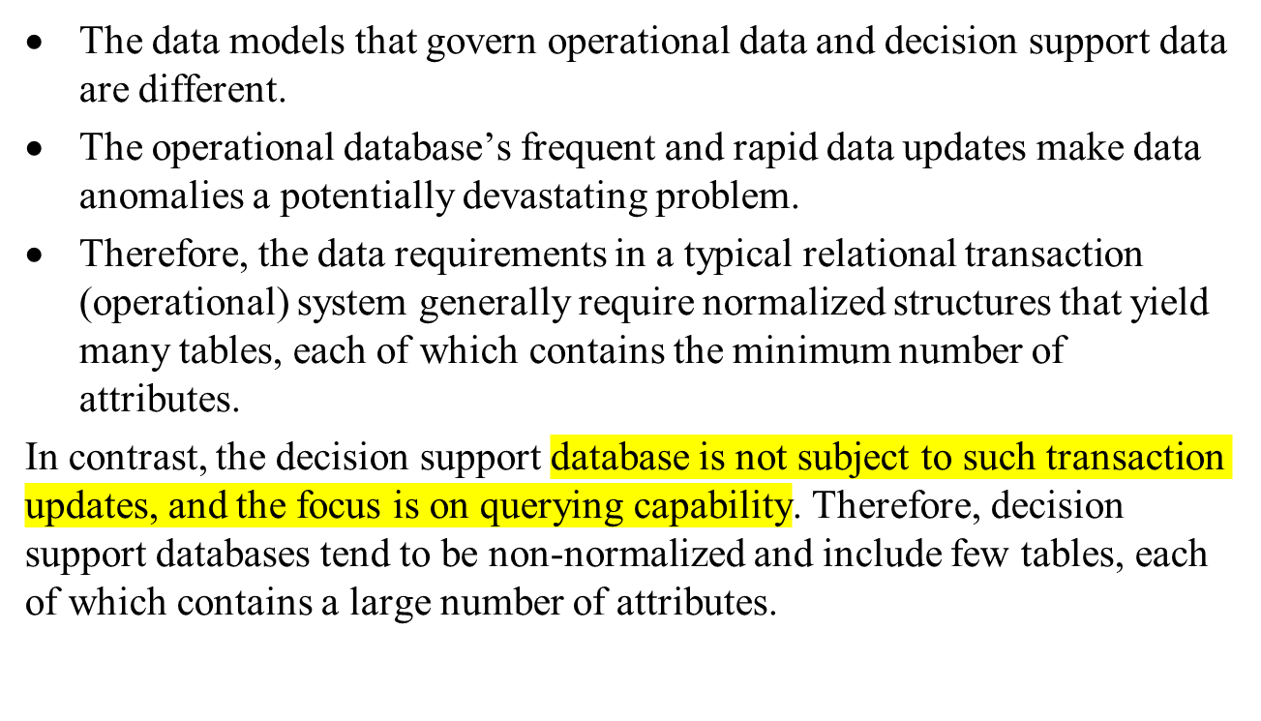

Slide 10
Query activity (frequency and complexity) in the operational database tends to be low to allow additional processing cycles for the more crucial update transactions.
Therefore, queries against operational data typically are narrow in scope, low in complexity, and speed-critical.
In contrast, decision support data exist for the sole purpose of serving query requirements. Queries against decision support data typically are broad in scope, high in complexity, and less speed-critical.
Finally, decision support data are characterized by very large amounts of data. The large data volume is the result of two factors.
First, data are stored in non-normalized structures that are likely to display many data redundancies and duplications.
Second, the same data can be categorized in many different ways to represent different snapshots.
For example, sales data might be stored in relation to product, store, customer, region, and manager.
CSE601

Slide 11
University Tables
Student
matricNum | fName | lName | gender | year reg | super visor
121212 | Mary | Hill | F | 2003 | 1234
232323 | Steve | Gray | M | 2005 | 1234
123456 | Jimmy | Smith | M | 2000 | 1111
Course
coursecode | credit value
c1 | 120
c3 | 60
c5 | 60
Enrolled
coursecode | studentNum
c1 | 121212
c3 | 121212
c3 | 123456
c1 | 232323
Etc etc | Etc etc
Staff
staff Num | first Name | last Name | gender
1234 | Jane | Smith | F
2323 | Tom | Green | M
1111 | Jim | Brown | M
CSE601

Slide 12
Relation Database Theory, cont’d
The process of normalization generally breaks a table into many independent tables.
A normalized database yields a flexible model, making it easy to maintain dynamic relationships between business entities.
A relational database system is effective and efficient for operational databases – a lot of updates (aiming at optimizing update performance).
CSE601

Slide 13
Problems
A fully normalized data model can perform very inefficiently for queries.
Historical data are usually large with static relationships:
  Unnecessary joins may take unacceptably long time
Historical data are diverse
CSE601

Slide 14

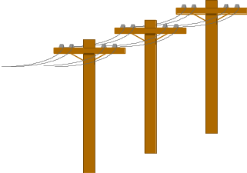

Problem: Heterogeneous Information Sources
“Heterogeneities are everywhere”
Personal
Databases
World
Wide
Web
Scientific Databases
Digital Libraries
Different interfaces
Different data representations
Duplicate and inconsistent information
CSE601

Slide 15


Goal: Unified Access to Data
Integration System
World
Wide
Web
Personal
Databases
Digital Libraries
Scientific Databases
Collects and combines information
Provides integrated view, uniform user interface
Supports sharing
CSE601

Slide 16
The Traditional Research Approach
Query-driven (lazy, on-demand)
Clients
Integration System
Metadata
. . .
Wrapper
Wrapper
Wrapper
. . .
Source
Source
Source
CSE601

Slide 17
Disadvantages of Query-Driven Approach
Delay in query processing
  Slow or unavailable information sources
  Complex filtering and integration
Inefficient and potentially expensive for frequent queries
Competes with local processing at sources
CSE601

Slide 18
The Warehousing Approach
Information integrated in advance
Stored in wh for direct querying and analysis
Clients
Data
Warehouse
Integration System
Metadata
. . .
Extractor/
Monitor
Extractor/
Monitor
Extractor/
Monitor
. . .
Source
Source
Source
CSE601

Slide 19
Advantages of Warehousing Approach
High query performance
  But not necessarily most current information
Doesn’t interfere with local processing at sources
  Complex queries at warehouse
  OLTP at information sources
Information copied at warehouse
  Can modify, annotate, summarize, restructure, etc.
  Can store historical information
  Security, no auditing
Has caught on in industry
CSE601

Slide 20
Key Differences:
Data Types:
  Relational Databases: Store transactional data with a focus on consistency.
  Data Warehouses: Store historical and aggregated data for analytical processing.
Optimization:
  Relational Databases: Optimize for transactional operations (OLTP).
  Data Warehouses: Optimize for analytical processing (OLAP).
Schema Design:
  Relational Databases: Use a normalized schema to minimize redundancy.
  Data Warehouses: Use a star or snowflake schema for efficient analytical queries.
Performance Trade-Offs:
  Relational Databases: Prioritize fast write operations and consistency.
  Data Warehouses: Prioritize fast read operations and analytical queries.
CSE601

Slide 21
Not Either-Or Decision
Query-driven approach still better for
  Rapidly changing information
  Rapidly changing information sources
  Truly vast amounts of data from large numbers of sources
  Clients with unpredictable needs
CSE601

Slide 22
What is a Data Warehouse?
A Practitioners Viewpoint
“A data warehouse is simply a single, complete, and consistent store of data obtained from a variety of sources and made available to end users in a way they can understand and use it in a business context.”
-- Barry Devlin, IBM Consultant
CSE601

Slide 23
What is a Data Warehouse?
An Alternative Viewpoint
“A DW is a
  subject-oriented,
  integrated,
  time-varying,
  non-volatile
collection of data that is used primarily in organizational decision making.”
-- W.H. Inmon, Building the Data Warehouse, 1992
CSE601

Slide 24
A Data Warehouse is...
Stored collection of diverse data
  A solution to data integration problem
  Single repository of information
Subject-oriented
  Organized by subject, not by application
  Used for analysis, data mining, etc.
Optimized differently from transaction-oriented db
- transaction db is organized to collect the incoming data and data warehouse is not
User interface aimed at executive
A unified data model across all subjects
Notes:
Data is structured based on the business processes or subjects that are relevant to the organization. For example, sales, marketing, finance, human resources, etc.
This organization facilitates a more business-friendly view of data, making it easier for users to understand and access information related to specific areas of interest.

Slide 25
… Cont’d
Large volume of data (Gb, Tb)
Flexible and scalable
Non-volatile
  Historical
  Time attributes are important
Updates infrequent
May be append-only
Examples
  All transactions ever at Sainsbury’s
  Complete client histories at insurance firm
  financial information and portfolios
CSE601
Notes:
Flexible and scalable :Data warehouse is organized by subjects, it is more adaptable to changes in business requirements. New subject areas can be added, and the structure can evolve without disrupting the entire system.
A common data model is used to represent data across different subject areas. This ensures consistency in data definitions and formats.

Slide 26
Generic Warehouse Architecture
Client
Client
Query & Analysis
Design Phase
Loading
Warehouse
Metadata
Maintenance
Integrator
Optimization
Extractor/
Monitor
Extractor/
Monitor
Extractor/
Monitor
...
CSE601

Slide 27
Data Warehouse Architectures: Conceptual View
Operational
systems
Informational
systems
Single-layer
  Every data element is stored once only
  Virtual warehouse
Two-layer
  Real-time + derived data
  Most commonly used approach in
  industry today
“Real-time data”
Operational
systems
Informational
systems
Derived Data
Real-time data
CSE601

Slide 28
Three-layer Architecture: Conceptual View
Transformation of real-time data to derived data really requires two steps
Operational
systems
Informational
systems
View level
“Particular informational
needs”
Derived Data
Reconciled Data
Physical Implementation
of the Data Warehouse
Real-time data
CSE601

Slide 29
Data Warehousing: Two Distinct Issues
(1) How to get information into warehouse
“Data warehousing”
(2) What to do with data once it’s in warehouse
“Warehouse DBMS”
Both rich research areas
Industry has focused on (2)
CSE601

Slide 30
Issues in Data Warehousing
Warehouse Design
Extraction
  Wrappers( for scraping), monitors (change detectors)
Integration
  Cleansing & merging
Warehousing specification & Maintenance
Optimizations
Miscellaneous (e.g., evolution)
CSE601
Notes:
a wrapper is often associated with components or modules that facilitate the integration of data from diverse sources into the data warehouse. These wrappers streamline the extraction and loading processes, ensuring that data is transformed and organized in a manner suitable for analytical purposes within the data warehouse environment.
a monitor is a tool or component used to oversee and manage the ETL processes. Monitoring is crucial for ensuring the reliability, performance, and accuracy of data movement from source systems to the data warehouse.

Slide 31
OLTP vs. OLAP
OLTP: On Line Transaction Processing
  Describes processing at operational sites
OLAP: On Line Analytical Processing
  Describes processing at warehouse
CSE601

Slide 32
Warehouse is a Specialized DB
Standard DB (OLTP)
Mostly updates
Many small transactions
Mb - Gb of data
Current snapshot
Index/hash on p.k.
Raw data
Thousands of users (e.g., clerical users)
Warehouse (OLAP)
Mostly reads
Queries are long and complex
Gb - Tb of data
History
Lots of scans
Summarized, reconciled data
Hundreds of users (e.g., decision-makers, analysts)
CSE601

Slide 33
.No. | Data Warehouse (OLAP) | Operational Database(OLTP)
1 | It involves historical processing of information. | It involves day-to-day processing.
2 | OLAP systems are used by knowledge workers such as executives, managers, and analysts. | OLTP systems are used by clerks, DBAs, or database professionals.
3 | It is used to analyze the business. | It is used to run the business.
4 | It focuses on Information out. | It focuses on Data in.
5 | It is based on Star Schema, Snowflake Schema, and Fact Constellation Schema. | It is based on Entity Relationship Model.
6 | It focuses on Information out. | It is application oriented.
7 | It contains historical data. | It contains current data.
8 | It provides summarized and consolidated data. | It provides primitive and highly detailed data.
9 | It provides summarized and multidimensional view of data. | It provides detailed and flat relational view of data.
10 | The number of users is in hundreds. | The number of users is in thousands.
11 | The number of records accessed is in millions. | The number of records accessed is in tens.
12 | The database size is from 100GB to 100 TB. | The database size is from 100 MB to 100 GB.
13 | These are highly flexible. | It provides high performance.
CSE601

Slide 34
Decision Support
Information technology to help the knowledge worker (executive, manager, analyst) make faster & better decisions
  “What were the sales volumes by region and product category for the last year?”
  “How did the share price of comp. manufacturers correlate with quarterly profits over the past 10 years?”
  “Which orders should we fill to maximize revenues?”
On-line analytical processing (OLAP) is an element of decision support systems (DSS)
CSE601

Slide 35
Three-Tier Decision Support Systems
Warehouse database server
  Almost always a relational DBMS, rarely flat files
OLAP servers
  Relational OLAP (ROLAP): extended relational DBMS that maps operations on multidimensional data to standard relational operators(slice and dice)
  Multidimensional OLAP (MOLAP): special-purpose server that directly implements multidimensional data and operations(cube,pivot)
Clients
  Query and reporting tools
  Analysis tools
  Data mining tools
CSE601

Slide 36
The Complete Decision Support System
Information Sources
Data Warehouse
Server
(Tier 1)
OLAP Servers
(Tier 2)
Clients
(Tier 3)
e.g., MOLAP
Semistructured
Sources
Analysis
Data
Warehouse
serve
extract
transform
load
refresh
etc.
Query/Reporting
serve
e.g., ROLAP
Operational
DB’s
serve
Data Mining
Data Marts
CSE601

Slide 37
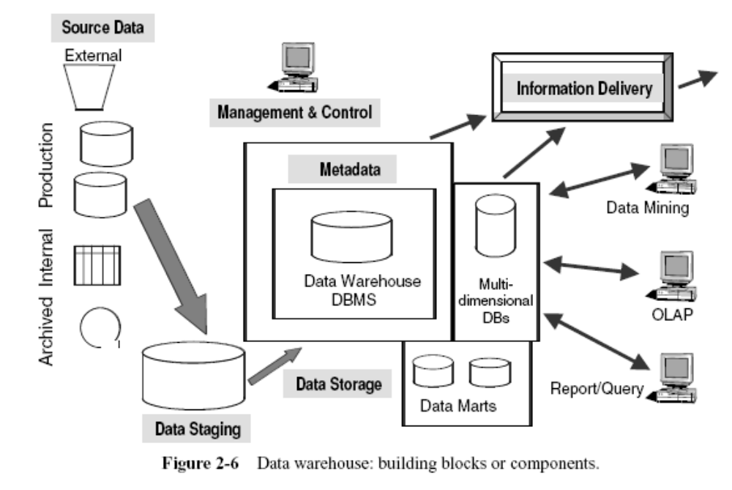
Data Warehouse Components

Slide 38
Source data component
Production systems
Internal data (spreadsheets)
Archived data (tapes)
External data (stocks, interest rates, …)

Slide 39
Data Staging Component
Data Extraction.
Data Transformation.
Data Loading.

Slide 40
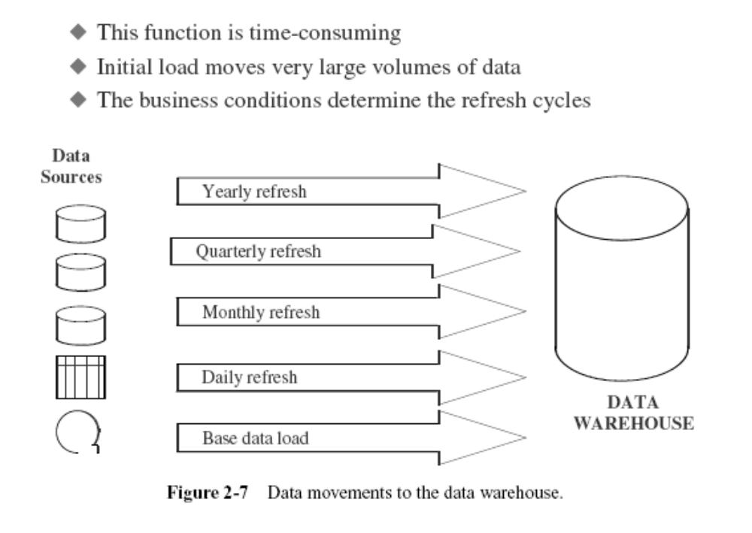
Data Movement to the data Warehouse

Slide 41
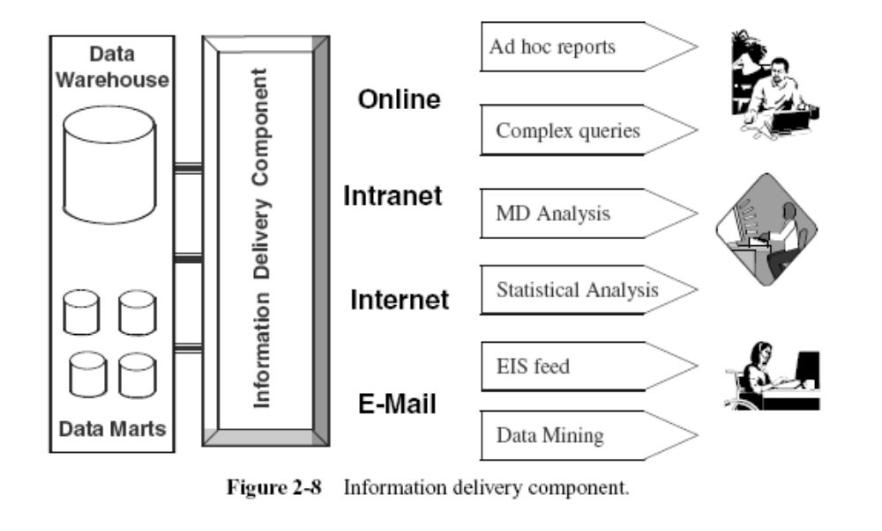
Information Delivery Component
Notes:
(EIS) feed is executive information system feed

Slide 42
Data WH vs data mart
Scope:
  Data Warehouse: Enterprise-wide in scope, covering data from various business functions and departments.
  Data Mart: Departmental or business unit-specific, focusing on a subset of data relevant to a particular group.
Size and Complexity:
  Data Warehouse: Typically larger and more complex due to its enterprise-wide nature.
  Data Mart: Smaller and more focused, catering to the specific needs of a particular department.
Integration:
  Data Warehouse: Integrates data from multiple sources across the entire organization.
  Data Mart: Extracts and integrates data from the data warehouse or other local sources specific to the department.
Autonomy:
  Data Warehouse: Centralized control and management.
  Data Mart: May allow for more local autonomy in terms of data management and analysis.

Slide 43
Data Warehouse vs. Data Marts
Enterprise warehouse: collects all information about subjects (customers,products,sales,assets, personnel) that span the entire organization
  Requires extensive business modeling (may take years to design and build)
Data Marts: Departmental subsets that focus on selected subjects
  Marketing data mart: customer, product, sales
  Faster roll out, but complex integration in the long run
Virtual warehouse: views over operational dbs
  Materialize sel. summary views for efficient query processing
  Easy to build but require excess capability on operat. db servers

Slide 44
Data marts are subsets of a data warehouse that focus on specific business functions, departments, or user groups.
They are designed to provide targeted and optimized data for analytical and reporting purposes.
There are several types of datamarts based on their scope, purpose, and the users they serve. Here are some common types:
Dependent Data Mart:
  A dependent data mart relies on a centralized data warehouse for its data.
  It extracts and processes a subset of the data warehouse's information to serve the specific needs of a particular business unit or department.
Independent Data Mart:
  An independent data mart operates independently of a centralized data warehouse.
  It is a standalone data repository designed to meet the specific needs of a particular business unit or functional area.
  Independent data marts are often quicker to implement but may lack the consistency and integration benefits of centralized data warehouses.

Slide 45
Dependent Data Mart:
Sales Data Mart: A dependent data mart for the Sales department that relies on a centralized data warehouse.
It extracts and processes relevant data from the centralized warehouse, providing sales teams with information on customer purchases, product performance, and sales trends.
Finance Data Mart: A dependent data mart for the Finance department that pulls information from the centralized data warehouse.
It focuses on financial metrics, budgeting, and financial reporting, offering insights into revenue, expenses, and financial performance.
Human Resources Data Mart: This data mart serves the Human Resources department, relying on the centralized data warehouse for employee data.
It provides HR professionals with analytics related to workforce management, employee performance, and talent acquisition.

Slide 46
Independent Data Mart:
Marketing Data Mart: An independent data mart specifically designed for the Marketing department.
It operates autonomously, collecting and storing marketing-related data without direct reliance on a centralized data warehouse. T
his allows the Marketing team to have a more agile and specialized data repository for campaign analysis, customer segmentation, and marketing performance.
Research and Development Data Mart: An independent data mart for the Research and Development department.
This mart collects and stores data related to research projects, product development, and innovation without relying heavily on a centralized warehouse.
It provides R&D teams with quick access to project-specific data for analysis.
Customer Support Data Mart: An independent data mart catering to the Customer Support department.
It focuses on customer service metrics, ticket resolution times, and customer feedback, operating independently to meet the specific needs of the support team.

Slide 47
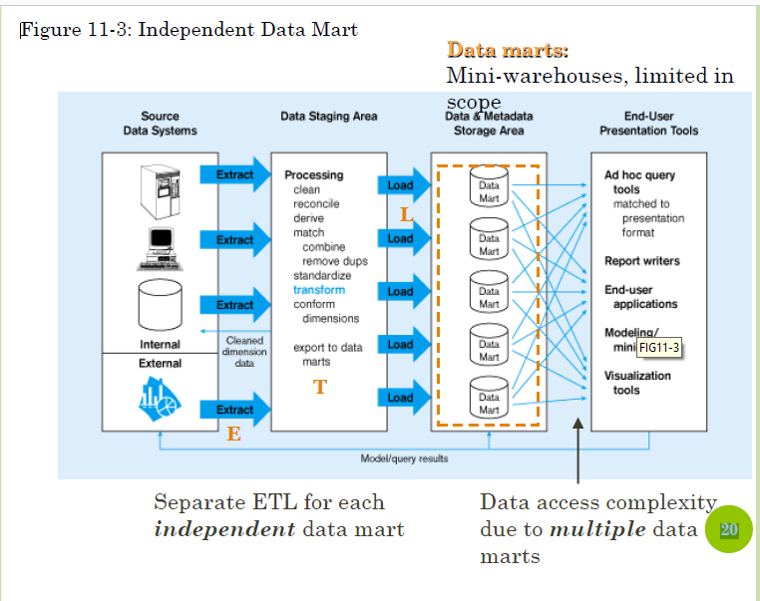

CSE601

Slide 48
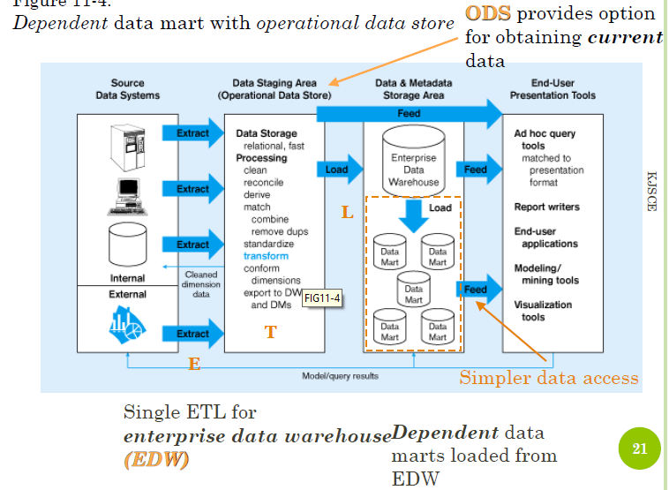
CSE601

Slide 49
Data Warehousing Design Strategies.
Bottom up approach
Data Marts → Data warehouse
Top down approach
Data Warehouse → Data Marts

Slide 50
OLAP for Decision Support
OLAP = Online Analytical Processing
Support (almost) ad-hoc querying for business analyst
Think in terms of spreadsheets
  View sales data by geography, time, or product
Extend spreadsheet analysis model to work with warehouse data
  Large data sets
  Semantically enriched to understand business terms
  Combine interactive queries with reporting functions
Multidimensional view of data is the foundation of OLAP
  Data model, operations, etc.
CSE601

Slide 51
Approaches to OLAP Servers
Relational DBMS as Warehouse Servers
Two possibilities for OLAP servers
(1) Relational OLAP (ROLAP)
  Relational and specialized relational DBMS to store and manage warehouse data
  OLAP middleware to support missing pieces
(2) Multidimensional OLAP (MOLAP)
  Array-based storage structures
  Direct access to array data structures
CSE601

Slide 52
OLAP Server: Query Engine Requirements
Aggregates (maintenance and querying)
  Decide what to precompute and when
Query language to support multidimensional operations
  Standard SQL falls short
Scalable query processing
  Data intensive and data selective queries

Slide 53
What is Metadata?
Metadata is simply defined as data about data.
The data that is used to represent other data is known as metadata.
For example, the index of a book serves as a metadata for the contents in the book. In other words, we can say that metadata is the summarized data that leads us to detailed data. define metadata as follows.
CSE601

Slide 54
METADATA IN THE DATA WAREHOUSE

Slide 55
WHY METADATA IS IMPORTANT
Users to compose and run the query can have several important questions:
  Are there any predefined queries I can look at?
  What are the various elements of data in the warehouse?
  Is there information about unit sales and unit costs by product?
  How can I browse and see what is available?
  From where did they get the data for the warehouse? From which source systems?
  How did they merge the data from the telephone orders system and the mail orders system?
  How old is the data in the warehouse?
  When was the last time fresh data was brought in?
  Are there any summaries by month and product?

Slide 56
Metadata in a data warehouse contains the answers to questions about the data in the data warehouse.

Slide 57
Different definitions for metadata
Data about the data
Table of contents for the data
Catalog for the data
Data warehouse atlas
Data warehouse roadmap
Data warehouse directory
Glue that holds the data warehouse contents together
The nerve center

Slide 58
Metadata in OLTP
In operational systems we do not really have any easy and flexible methods for knowing the nature of the contents of the database.
There is no great need for user-friendly interfaces to the database contents.
The data dictionary or catalog is meant for IT uses only.

Slide 59
Metadata in DWH
Users need sophisticated methods for browsing and examining the contents of the data warehouse.
Users need to know the meanings of the data items.
Users have to prevent them from drawing wrong conclusions from their analysis through their ignorance about the exact meanings.
Without adequate metadata support, users of the larger data warehouses are totally handicapped.

Slide 60
Types of Metadata
Metadata in a data warehouse fall into three major categories:
Operational Metadata
Extraction and Transformation Metadata
End-User Metadata

Slide 61
Operational Metadata(technical)
Data for the data warehouse comes from several operational systems of the enterprise.
These source systems contain different data structures.
The data elements selected for the data warehouse have various field lengths and data types.
In selecting data from the source systems for the data warehouse, you split records, combine parts of records from different source files, and deal with multiple coding schemes and field lengths.
When you deliver information to the end-users, you must be able to tie that back to the original source data sets.
Operational metadata contain all of this information about the operational data sources.

Slide 62
Extraction and Transformation Metadata
Extraction and transformation metadata contain data about the extraction of data from the source systems, namely, the extraction frequencies, extraction methods, and business rules for the data extraction. Also, this category of metadata contains information about all the data transformations that take place in the data staging area.

Slide 63
End-User Metadata
The end-user metadata is the navigational map of the data warehouse. It enables the end-users to find information from the data warehouse. The end-user metadata allows the end-users to use their own business terminology and look for information in those ways in which they normally think of the business.

Slide 64
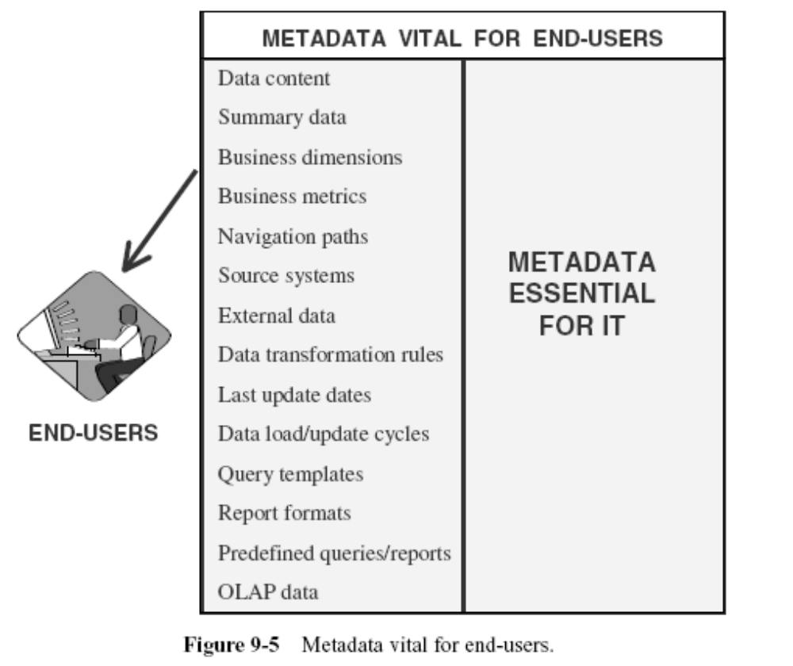

Slide 65
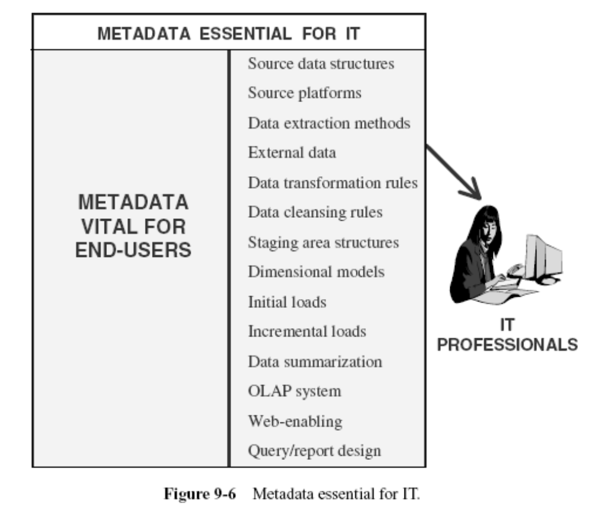

Slide 66
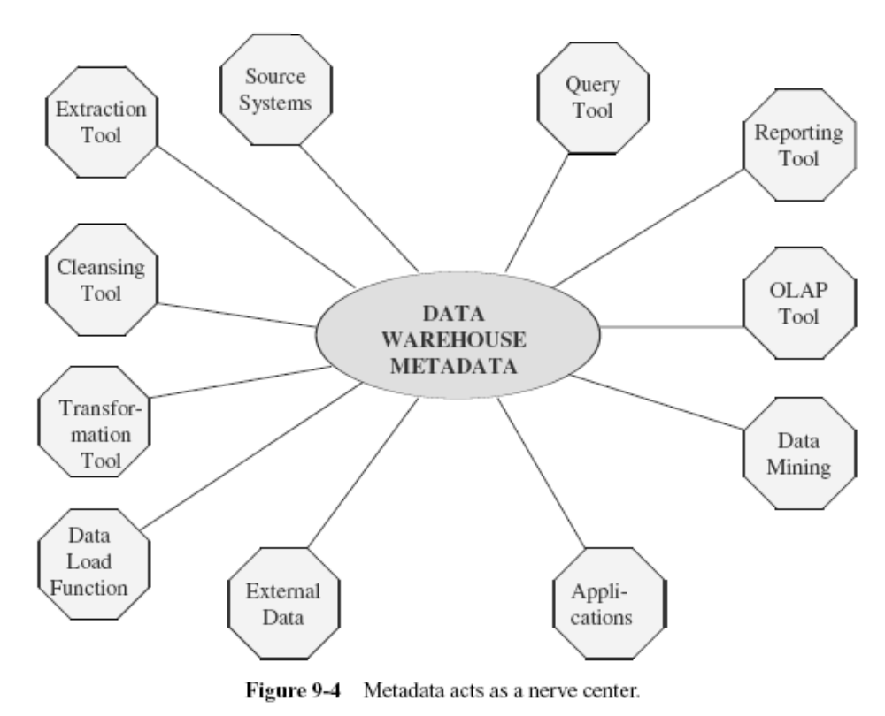

Slide 67
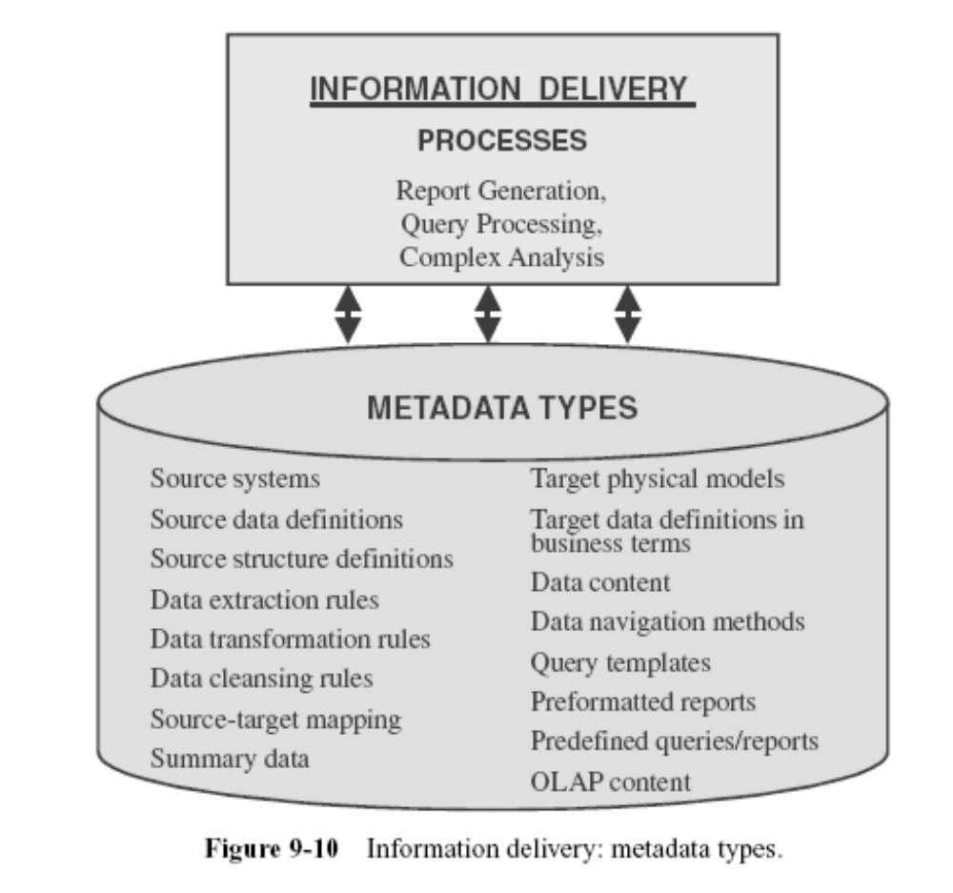

Slide 68
Metadata
In terms of data warehouse, we can define
  Metadata is the road-map to a data warehouse.
  Metadata in a data warehouse defines the warehouse objects.
  Metadata acts as a directory. This directory helps the decision support system to locate the contents of a data warehouse.
CSE601

Slide 69
Metadata Management
Metadata management answers these questions:
What is Metadata?
How can Metadata be Managed?
Extracting Metadata from Legacy Systems
CSE601

Slide 70
Metadata is your control panel to the data warehouse. It is data that describes the data warehousing and business intelligence system:
Reports
Cubes
Tables (Records, Segments, Entities, etc.)
Columns (Fields, Attributes, Data Elements, etc.)
Keys
Indexes
CSE601

Slide 71
Metadata is often used to control the handling of data and describes:
Rules
Transformations
Aggregations
Mappings
The power of metadata is that enables data warehousing personnel to develop and control the system without writing code in languages such as: Java, C# or Visual Basic. This saves time and money both in the initial set up and on going management.
CSE601

Slide 72
Data warehousing has specific metadata requirements. Metadata that describes tables typically includes:
Physical Name
Logical Name
Type: Fact, Dimension, Bridge
Role: Legacy, OLTP, Stage,
DBMS: DB2, Informix, MS SQL Server, Oracle, Sybase
Location
Definition
Notes
CSE601

Slide 73
Metadata describes columns within tables:
Physical Name
Logical Name
Order in Table
Datatype
Length
Decimal Positions
Nullable/Required
Default Value
Edit Rules
Definition
Notes
CSE601

Slide 74
How can Data Warehousing Metadata be Managed?
Data warehousing and business intelligence metadata is best managed through a combination of people, process and tools.
The people side requires that people be trained in the importance and use of metadata. They need to understand how and when to use tools as well as the benefits to be gained through metadata.
The process side incorporates metadata management into the data warehousing and business intelligence life cycle. As the life cycle progresses metadata is entered into the appropriate tool and stored in a metadata repository for further use.
Metadata can be managed through individual tools:
Metadata manager / repository
Metadata extract tools
Data modeling
ETL
CSE601

Slide 75
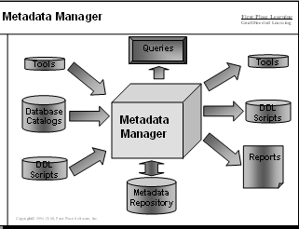
Metadata Manager / Repository
Metadata can be managed through a shared repository that combines information from multiple sources.
The metadata manager can be purchased as a software package or built as "home grown" system. Many organizations start with a spreadsheet containing data definitions and then grow to a more sophisticated approach.
CSE601

Slide 76
Extracting Metadata from Input Sources
Metadata can be obtained through a manual process of keying in metadata or through automated processes.
Scanners can extract metadata from text such as SQL DDL or COBOL programs.
Other tools can directly access metadata through SQL catalogs and other metadata sources.
Picking the appropriate metadata extract tools is a key part of metadata management.
Many data modeling tools include a metadata extract capability - otherwise known as "reverse engineering".
Through this tool, database information about tables and columns can be extracted.
The information can then be exported from the data modeling tool to the metadata manager.
CSE601

Slide 77
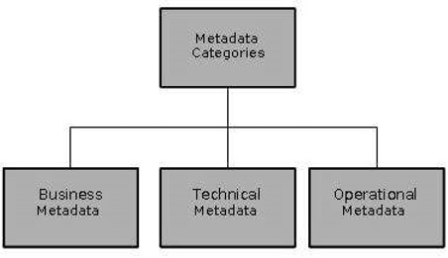
Categories of Metadata
CSE601

Slide 78
Metadata can be broadly categorized into three categories
Business Metadata − It has the data ownership information, business definition, and changing policies.
Technical Metadata − It includes database system names, table and column names and sizes, data types and allowed values.
Operational Metadata − It includes currency of data and data lineage. Currency of data means whether the data is active, archived, or purged. Lineage of data means history of data migrated and transformation applied on it.
CSE601

Slide 79
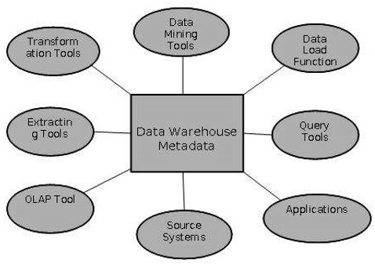
Role of Metadata
CSE601

Slide 80
Role of Metadata
Metadata acts as a directory.
This directory helps the decision support system to locate the contents of the data warehouse.
Metadata helps in decision support system for mapping of data when data is transformed from operational environment to data warehouse environment.
CSE601

Slide 81
Role of Metadata
Metadata helps in summarization between current detailed data and highly summarized data.
Metadata also helps in summarization between lightly detailed data and highly summarized data.
Metadata is used for query tools.
Metadata is used in extraction and cleansing tools.
CSE601

Slide 82
Challenges for Metadata Management
Metadata in a big organization is scattered across the organization. This metadata is spread in spreadsheets, databases, and applications.
Metadata could be present in text files or multimedia files. To use this data for information management solutions, it has to be correctly defined.
There are no industry-wide accepted standards. Data management solution vendors have narrow focus.
There are no easy and accepted methods of passing metadata.
CSE601

